Slide 1
COM2067
Chapter 14: Searching and Sorting
Data Structures Using C, Second Edition

Slide 2
Searching
Sorting

Slide 3
INTRODUCTION TO SEARCHING
Searching means to find whether a particular value is present in an array or not.
If the value is present in the array, then searching is said to be successful and the searching process gives the location of that value in the array.
However, if the value is not present in the array, the searching process displays an appropriate message and in this case searching is said to be unsuccessful.
There are two popular methods for searching the array elements: linear search and binary search.
The algorithm that should be used depends entirely on how the values are organized in the array.

Slide 4
Linear Search
Linear search, also called as sequential search, is a very simple method used for searching an array for a particular value.
It works by comparing the value to be searched with every element of the array one by one in a sequence until a match is found.
Linear search is mostly used to search an unordered list of elements (array in which data elements are not sorted).
For example, if an array A[] is declared and initialized as, int A[] = {10, 8, 2, 7, 3, 4, 9, 1, 6, 5}; and the value to be searched is VAL = 7, then searching means to find whether the value ‘7’ is present in the array or not.
If yes, then it returns the position of its occurrence. Here, POS = 3 (index starting from 0).

Slide 5
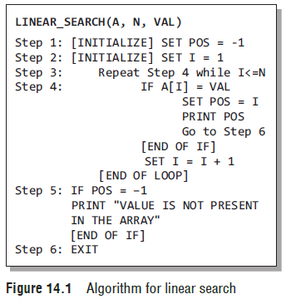
Linear Search
Figure 14.1 shows the algorithm for linear search.
In Steps 1 and 2 of the algorithm, we initialize the value of POS and I.
In Step 3, a while loop is executed that would be executed till I is less than N (total number of elements in the array).
In Step 4, a check is made to see if a match is found between the current array element and VAL.
If a match is found, then the position of the array element is printed, else the value of I is incremented to match the next element with VAL.
However, if all the array elements have been compared with VAL and no match is found, then it means that VAL is not present in the array.

Slide 6
Linear Search
Complexity of Linear Search Algorithm
Linear search executes in O(n) time where n is the number of elements in the array.
Obviously, the best case of linear search is when VAL is equal to the first element of the array.
In this case, only one comparison will be made.
Likewise, the worst case will happen when either VAL is not present in the array or it is equal to the last element of the array.
In both the cases, n comparisons will have to be made.

Slide 7
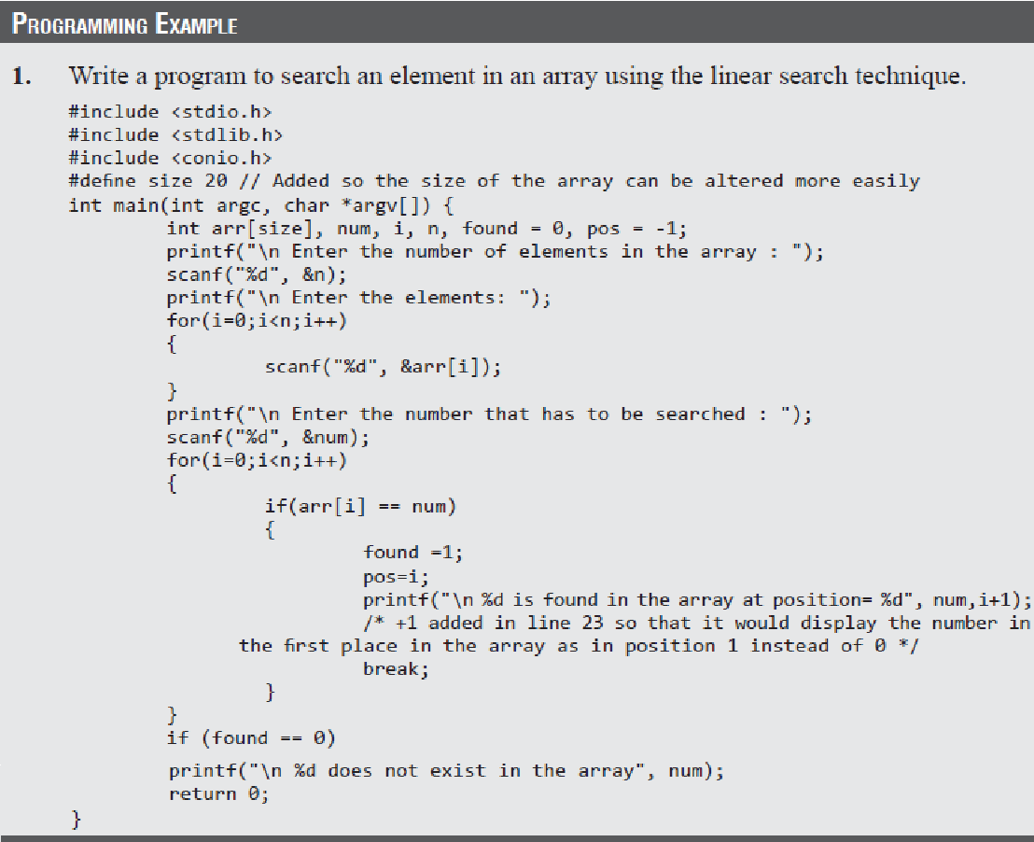
Linear Search

Slide 8
Binary Search
Binary search is a searching algorithm that works efficiently with a sorted list.
How do we find words in a dictionary? We first open the dictionary somewhere in the middle. Then, we compare the first word on that page with the desired word whose meaning we are looking for. If the desired word comes before the word on the page, we look in the first half of the dictionary, else we look in the second half. Again, we open a page in the first half of the dictionary and compare the first word on that page with the desired word and repeat the same procedure until we finally get the word.

Slide 9
Binary Search
Now, let us consider how this mechanism is applied to search for a value in a sorted array.
Consider an array A[] that is declared and initialized as
int A[] = {0, 1, 2, 3, 4, 5, 6, 7, 8, 9, 10};
and the value to be searched is VAL = 9.
The algorithm will proceed in the following manner.
BEG = 0, END = 10, MID = (0 + 10)/2 = 5
Now, VAL = 9 and A[MID] = A[5] = 5
A[5] is less than VAL, therefore, we now search for the value in the second half of the array.
So, we change the values of BEG and MID.
Now, BEG = MID + 1 = 6, END = 10, MID = (6 + 10)/2 =16/2 = 8
VAL = 9 and A[MID] = A[8] = 8
A[8] is less than VAL, therefore, we now search for the value in the second half of the segment.
So, again we change the values of BEG and MID.
Now, BEG = MID + 1 = 9, END = 10, MID = (9 + 10)/2 = 9
Now, VAL = 9 and A[MID] = 9.

Slide 10
Binary Search
In this algorithm, we see that BEG and END are the beginning and ending positions of the segment that we are looking to search for the element.
MID is calculated as (BEG + END)/2.
Initially, BEG = lower_bound and END = upper_bound.
The algorithm will terminate when A[MID] = VAL.
When the algorithm ends, we will set POS = MID.
POS is the position at which the value is present in the array.
However, if VAL is not equal to A[MID], then the values of BEG, END, and MID will be changed depending on whether VAL is smaller or greater than A[MID]. (
a) If VAL < A[MID], then VAL will be present in the left segment of the array. So, the value of END will be changed as END = MID – 1.
(b) If VAL > A[MID], then VAL will be present in the right segment of the array. So, the value of BEG will be changed as BEG = MID + 1.
Finally, if VAL is not present in the array, then eventually, END will be less than BEG. When this happens, the algorithm will terminate and the search will be unsuccessful.

Slide 11
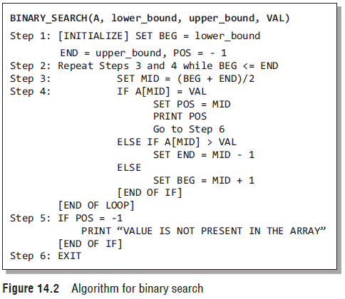
Binary Search
Figure 14.2 shows the algorithm for binary search.
In Step 1, we initialize the value of variables, BEG, END, and POS.
In Step 2, a while loop is executed until BEG is less than or equal to END.
In Step 3, the value of MID is calculated.
In Step 4, we check if the array value at MID is equal to VAL (item to be searched in the array).
If a match is found, then the value of POS is printed and the algorithm exits.
However, if a match is not found, and if the value of A[MID] is greater than VAL, the value of END is modified, otherwise if A[MID] is greater than VAL, then the value of BEG is altered.
In Step 5, if the value of POS = –1, then VAL is not present in the array and an appropriate message is printed on the screen before the algorithm exits.

Slide 12
Binary Search
Complexity of Binary Search Algorithm
The complexity of the binary search algorithm can be expressed as f(n), where n is the number of elements in the array.
The complexity of the algorithm is calculated depending on the number of comparisons that are made.
In the binary search algorithm, we see that with each comparison, the size of the segment where search has to be made is reduced to half.
Thus, we can say that, in order to locate a particular value in the array, the total number of comparisons that will be made is given as
2^{f(n)} > n or f(n) = log2n

Slide 13
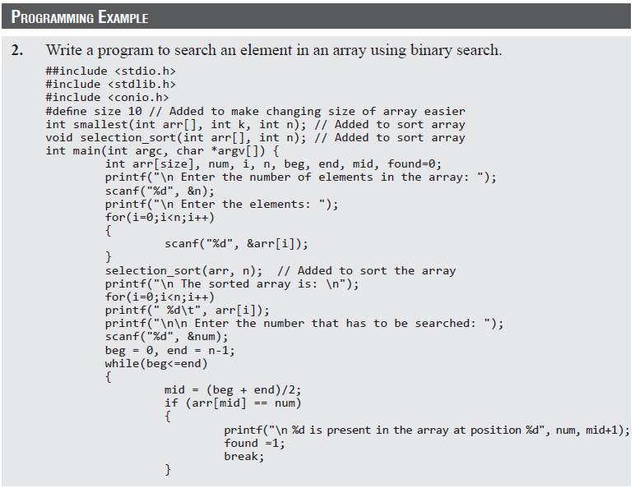
Binary Search

Slide 14
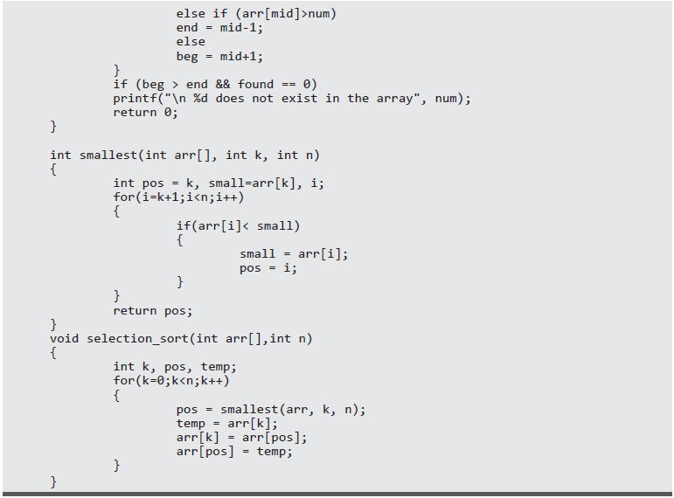
Binary Search

Slide 15
Interpolation Search
Interpolation search, also known as extrapolation search, is a searching technique that finds a specified value in a sorted array.
The concept of interpolation search is similar to how we search for names in a telephone book or for keys by which a book’s entries are ordered.
For example, when looking for a name “Bharat” in a telephone directory, we know that it will be near the extreme left, so applying a binary search technique by dividing the list in two halves each time is not a good idea.
We must start scanning the extreme left in the first pass itself.
In each step of interpolation search, the remaining search space for the value to be found is calculated.
The calculation is done based on the values at the bounds of the search space and the value to be searched.
The value found at this estimated position is then compared with the value being searched for.
If the two values are equal, then the search is complete.

Slide 16
Interpolation Search
However, in case the values are not equal then depending on the comparison, the remaining search space is reduced to the part before or after the estimated position.
Thus, we see that interpolation search is similar to the binary search technique.
However, the important difference between the two techniques is that binary search always selects the middle value of the remaining search space. It discards half of the values based on the comparison between the value found at the estimated position and the value to be searched.
But in interpolation search, interpolation is used to find an item near the one being searched for.

Slide 17
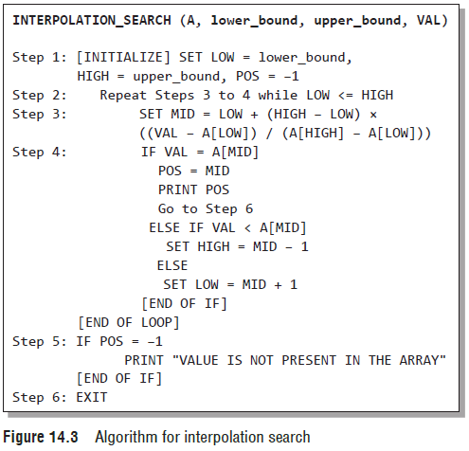
Interpolation Search
The algorithm for interpolation search is given in Fig. 14.3.

Slide 18
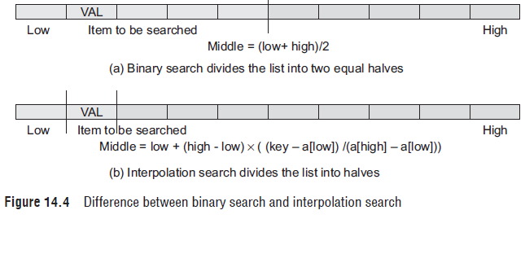
Interpolation Search
Figure 14.4 helps us to visualize how the search space is divided in case of binary search and interpolation search.

Slide 19
Interpolation Search
Complexity of Interpolation Search Algorithm
When n elements of a list to be sorted are uniformly distributed (average case), interpolation search makes about log(log n) comparisons.
However, in the worst case, that is when the elements increase exponentially, the algorithm can make up to O(n) comparisons.

Slide 20
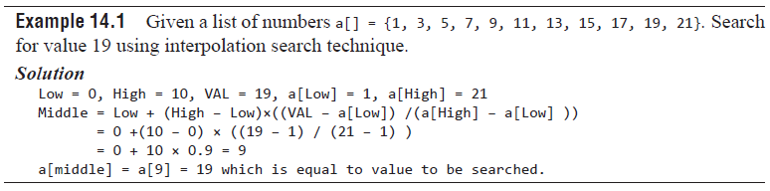
Interpolation Search

Slide 21
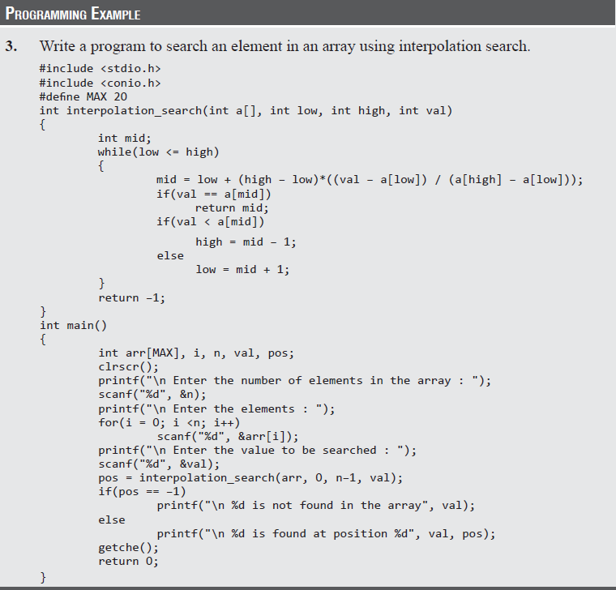
Interpolation Search

Slide 22
Jump Search
When we have an already sorted list, then the other efficient algorithm to search for a value is jump search or block search.
In jump search, it is not necessary to scan all the elements in the list to find the desired value.
We just check an element and if it is less than the desired value, then some of the elements following it are skipped by jumping ahead.
After moving a little forward again, the element is checked.
If the checked element is greater than the desired value, then we have a boundary and we are sure that the desired value lies between the previously checked element and the currently checked element.
However, if the checked element is less than the value being searched for, then we again make a small jump and repeat the process.
Once the boundary of the value is determined, a linear search is done to find the value and its position in the array.

Slide 23
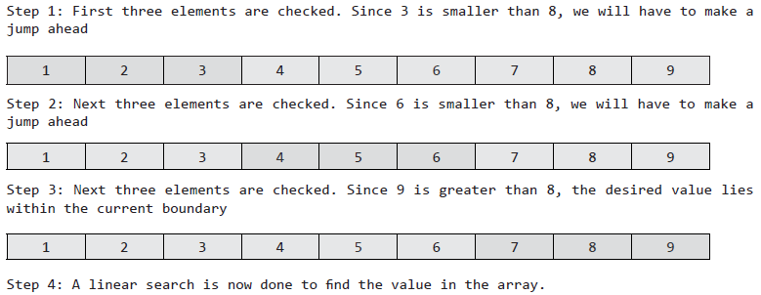
Jump Search
For example, consider an array
a[] = {1,2,3,4,5,6,7,8,9}.
The length of the array is 9.
If we have to find value 8 then following steps are performed using the jump search technique.

Slide 24
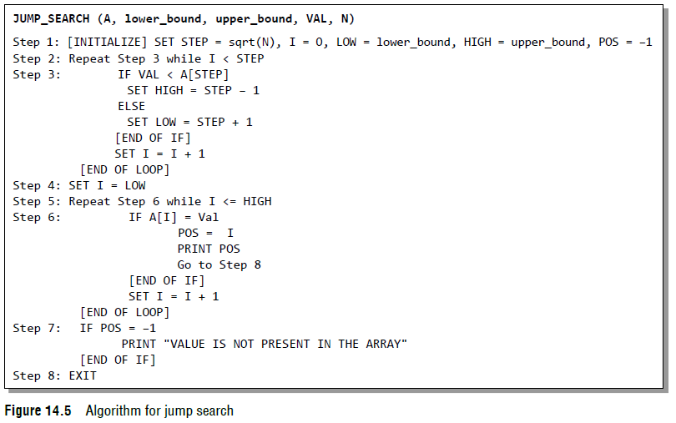
Jump Search
The algorithm for jump search is given in Fig. 14.5.

Slide 25
Jump Search
Advantage of Jump Search over Linear Search
Suppose we have a sorted list of 1000 elements where the elements have values 0, 1, 2, 3, 4, …, 999, then sequential search will find the value 674 in exactly 674 iterations.
But with jump search, the same value can be found in 44 iterations. Hence, jump search performs far better than a linear search on a sorted list of elements.
Advantage of Jump Search over Binary Search
No doubt, binary search is very easy to implement and has a complexity of O(log n), but in case of a list having very large number of elements, jumping to the middle of the list to make comparisons is not a good idea because if the value being searched is at the beginning of the list then one (or even more) large step(s) in the backward direction would have to be taken.
In such cases, jump search performs better as we have to move little backward that too only once. Hence, when jumping back is slower than jumping forward, the jump search algorithm always performs better.

Slide 26
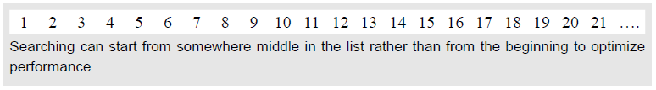
Jump Search
How to Choose the Step Length?
For the jump search algorithm to work efficiently, we must define a fixed size for the step.
If the step size is 1, then algorithm is same as linear search.
Now, in order to find an appropriate step size, we must first try to figure out the relation between the size of the list (n) and the size of the step (k). Usually, k is calculated as √n.
Further Optimization of Jump Search
Till now, we were dealing with lists having small number of elements. But in real-world applications, lists can be very large. In such large lists searching the value from the beginning of the list may not be a good idea.
A better option is to start the search from the k–th element as shown in the figure below.

Slide 27
Jump Search
We can also improve the performance of jump search algorithm by repeatedly applying jump search.
For example, if the size of the list is 1000000 (n).
The jump interval would then be
√n =√1000000 =1000.
Now, even the identified interval has 1000 elements and is again a large list. So, jump search can be applied again with a new step size of
√1000 ≈ 31.
Thus, every time we have a desired interval with a large number of values, the jump search algorithm can be applied again but with a smaller step.
However, in this case, the complexity of the algorithm will no longer be O(√n) but will approach a logarithmic value.

Slide 28
Jump Search
Complexity of Jump Search Algorithm
Jump search works by jumping through the array with a step size (optimally chosen to be √n) to find the interval of the value.
Once this interval is identified, the value is searched using the linear search technique.
Therefore, the complexity of the jump search algorithm can be given as O(√n).

Slide 29
INTRODUCTION TO SORTING
Sorting means arranging the elements of an array so that they are placed in some relevant order which may be either ascending or descending.
That is, if A is an array, then the elements of A are arranged in a sorted order (ascending order) in such a way that
A[0] < A[1] < A[2] < ...... < A[N].
For example, if we have an array that is declared and initialized as
int A[] = {21, 34, 11, 9, 1, 0, 22};
Then the sorted array (ascending order) can be given as:
A[] = {0, 1, 9, 11, 21, 22, 34;
A sorting algorithm is defined as an algorithm that puts the elements of a list in a certain order, which can be either numerical order, lexicographical order, or any user-defined order.
Efficient sorting algorithms are widely used to optimize the use of other algorithms like search and merge algorithms which require sorted lists to work correctly.

Slide 30
Bubble Sort
Bubble sort is a very simple method that sorts the array elements by repeatedly moving the largest element to the highest index position of the array segment (in case of arranging elements in ascending order).
In bubble sorting, consecutive adjacent pairs of elements in the array are compared with each other.
If the element at the lower index is greater than the element at the higher index, the two elements are interchanged so that the element is placed before the bigger one.
This process will continue till the list of unsorted elements exhausts.
This procedure of sorting is called bubble sorting because elements ‘bubble’ to the top of the list.
At the end of the first pass, the largest element in the list will be placed at its proper position
Note If the elements are to be sorted in descending order, then in first pass the smallest element is moved to the highest index of the array.

Slide 31
Bubble Sort
Technique
The basic methodology of the working of bubble sort is given as follows:
In Pass 1, A[0] and A[1] are compared, then A[1] is compared with A[2], A[2] is compared with A[3], and so on. Finally, A[N–2] is compared with A[N–1]. Pass 1 involves n–1 comparisons and places the biggest element at the highest index of the array.
In Pass 2, A[0] and A[1] are compared, then A[1] is compared with A[2], A[2] is compared with A[3], and so on. Finally, A[N–3] is compared with A[N–2]. Pass 2 involves n–2 comparisons and places the second biggest element at the second highest index of the array.
In Pass 3, A[0] and A[1] are compared, then A[1] is compared with A[2], A[2] is compared with A[3], and so on. Finally, A[N–4] is compared with A[N–3]. Pass 3 involves n–3 comparisons and places the third biggest element at the third highest index of the array.
In Pass n–1, A[0] and A[1] are compared so that A[0]<A[1]. After this step, all the elements of the array are arranged in ascending order.

Slide 32
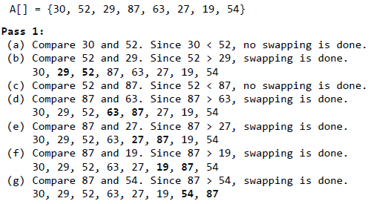
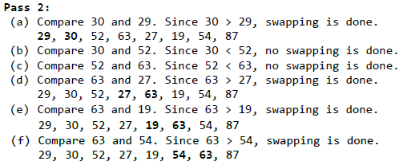
Bubble Sort
Example 14.2 To discuss bubble sort in detail, let us consider an array A[] that has the following elements:
Observe that after the end of the first pass, the largest element is placed at the highest index of the array. All the other elements are still unsorted.
Observe that after the end of the second pass, the second largest element is placed at the second highest index of the array. All the other elements are still unsorted.

Slide 33
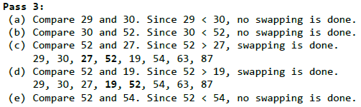
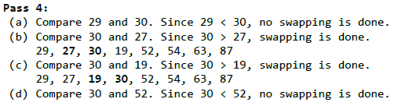
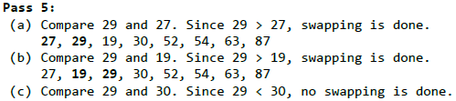
Bubble Sort
Observe that after the end of the third pass, the third largest element is placed at the third highest index of the array. All the other elements are still unsorted.
Observe that after the end of the fourth pass, the fourth largest element is placed at the fourth highest index of the array. All the other elements are still unsorted.
Observe that after the end of the fifth pass, the fifth largest element is placed at the fifth highest index of the array. All the other elements are still unsorted.

Slide 34

Bubble Sort
Observe that after the end of the sixth pass, the sixth largest element is placed at the sixth largest index of the array. All the other elements are still unsorted.
Observe that the entire list is sorted now.

Slide 35
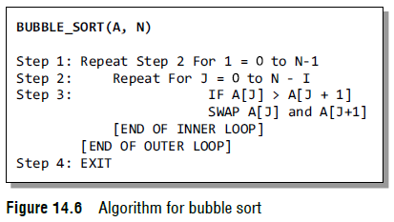
Bubble Sort
Figure 14.6 shows the algorithm for bubble sort.
In this algorithm, the outer loop is for the total number of passes which is N–1.
The inner loop will be executed for every pass. However, the frequency of the inner loop will decrease with every pass because after every pass, one element will be in its correct position.
Therefore, for every pass, the inner loop will be executed N–I times, where N is the number of elements in the array and I is the count of the pass.

Slide 36
Bubble Sort
Complexity of Bubble Sort
The complexity of any sorting algorithm depends upon the number of comparisons.
In bubble sort, we have seen that there are N–1 passes in total.
In the first pass, N–1 comparisons are made to place the highest element in its correct position.
Then, in Pass 2, there are N–2 comparisons and the second highest element is placed in its position.
Therefore, to compute the complexity of bubble sort, we need to calculate the total number of comparisons. It can be given as:
f(n) = (n – 1) + (n – 2) + (n – 3) + ..... + 3 + 2 + 1
f(n) = n (n – 1)/2
f(n) = n²/2 + O(n) = O(n²)
Therefore, the complexity of bubble sort algorithm is O(n²). It means the time required to execute bubble sort is proportional to n², where n is the total number of elements in the array.

Slide 37
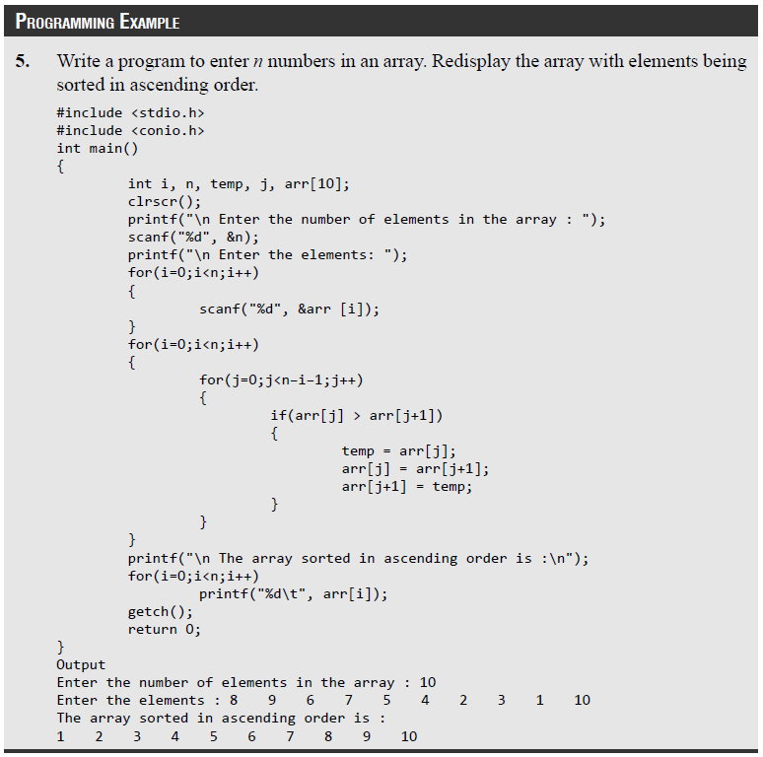
Bubble Sort

Slide 38
Insertion Sort
Insertion sort is a very simple sorting algorithm in which the sorted array (or list) is built one element at a time. We all are familiar with this technique of sorting, as we usually use it for ordering a deck of cards while playing bridge.
The main idea behind insertion sort is that it inserts each item into its proper place in the final list.
To save memory, most implementations of the insertion sort algorithm work by moving the current data element past the already sorted values and repeatedly interchanging it with the preceding value until it is in its correct place.
Insertion sort is less efficient as compared to other more advanced algorithms such as quick sort, heap sort, and merge sort.

Slide 39
Insertion Sort
Technique
Insertion sort works as follows:
The array of values to be sorted is divided into two sets. One that stores sorted values and another that contains unsorted values.
The sorting algorithm will proceed until there are elements in the unsorted set.
Suppose there are n elements in the array. Initially, the element with index 0 (assuming LB = 0) is in the sorted set. Rest of the elements are in the unsorted set.
The first element of the unsorted partition has array index 1 (if LB = 0).
During each iteration of the algorithm, the first element in the unsorted set is picked up and inserted into the correct position in the sorted set.

Slide 40
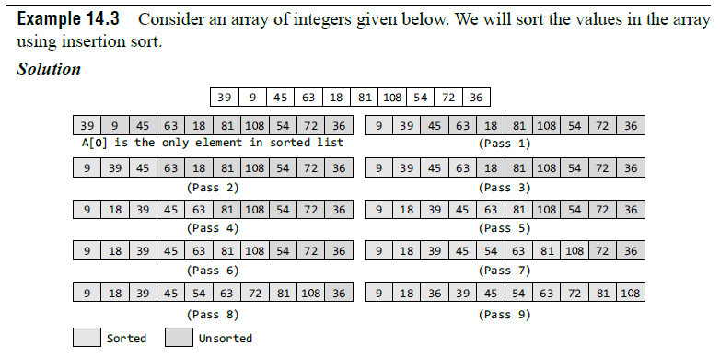
Insertion Sort
Initially, A[0] is the only element in the sorted set. In Pass 1, A[1] will be placed either before or after A[0], so that the array A is sorted. In Pass 2, A[2] will be placed either before A[0], in between A[0] and A[1], or after A[1]. In Pass 3, A[3] will be placed in its proper place. In Pass N–1, A[N–1] will be placed in its proper place to keep the array sorted.

Slide 41
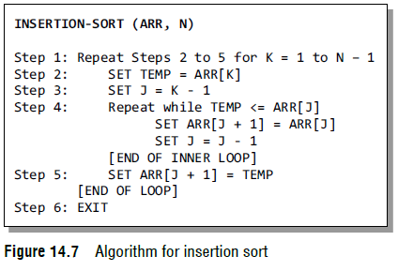
Insertion Sort
To insert an element A[K] in a sorted list A[0], A[1], ..., A[K-1], we need to compare A[K] with A[K–1], then with A[K–2], A[K–3], and so on until we meet an element A[J] such that A[J] <= A[K]. In order to insert A[K] in its correct position, we need to move elements A[K–1], A[K–2], ..., A[J] by one position and then A[K] is inserted at the (J+1)^{th} location.
The algorithm for insertion sort is given in Fig. 14.7.
In the algorithm, Step 1 executes a for loop which will be repeated for each element in the array.
In Step 2, we store the value of the Kth element in TEMP.
In Step 3, we set the J^{th} index in the array.
In Step 4, a for loop is executed that will create space for the new element from the unsorted list to be stored in the list of sorted elements.
Finally, in Step 5, the element is stored at the (J+1)^{th} location.

Slide 42
Insertion Sort
Complexity of Insertion Sort
For insertion sort, the best case occurs when the array is already sorted.
In this case, the running time of the algorithm has a linear running time (i.e., O(n)). This is because, during each iteration, the first element from the unsorted set is compared only with the last element of the sorted set of the array.
Similarly, the worst case of the insertion sort algorithm occurs when the array is sorted in the reverse order.
In the worst case, the first element of the unsorted set has to be compared with almost every element in the sorted set. Furthermore, every iteration of the inner loop will have to shift the elements of the sorted set of the array before inserting the next element. Therefore, in the worst case, insertion sort has a quadratic running time (i.e., O(n2)).
Even in the average case, the insertion sort algorithm will have to make at least (K–1)/2 comparisons. Thus, the average case also has a quadratic running time.

Slide 43
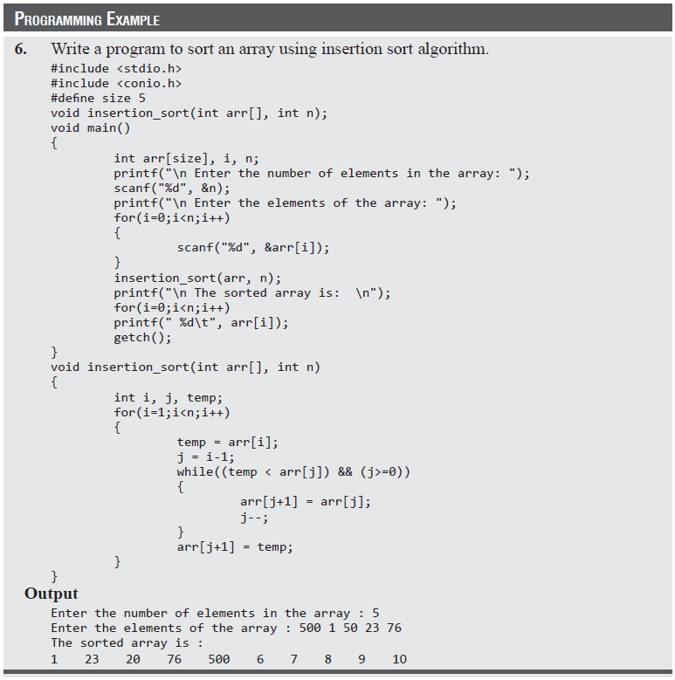
Insertion Sort

Slide 44
Selection Sort
Selection sort is a sorting algorithm that has a quadratic running time complexity of O(n2), thereby making it inefficient to be used on large lists.
Although selection sort performs worse than insertion sort algorithm, it is noted for its simplicity and also has performance advantages over more complicated algorithms in certain situations.
Selection sort is generally used for sorting files with very large objects (records) and small keys.
Technique
Consider an array ARR with N elements.
Selection sort works as follows:
First find the smallest value in the array and place it in the first position. Then, find the second smallest value in the array and place it in the second position. Repeat this procedure until the entire array is sorted. Therefore,
In Pass 1, find the position POS of the smallest value in the array and then swap ARR[POS] and ARR[0]. Thus, ARR[0] is sorted.
In Pass 2, find the position POS of the smallest value in sub-array of N–1 elements. Swap ARR[POS] with ARR[1]. Now, ARR[0] and ARR[1] is sorted.
In Pass N–1, find the position POS of the smaller of the elements ARR[N–2] and ARR[N–1]. Swap ARR[POS] and ARR[N–2] so that ARR[0], ARR[1], ..., ARR[N–1] is sorted.

Slide 45
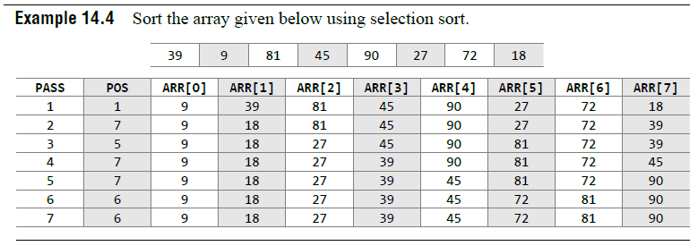
Selection Sort

Slide 46
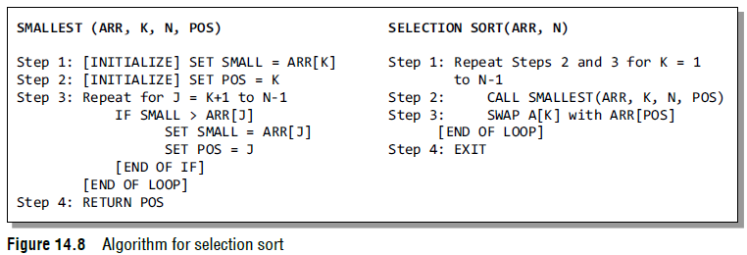
Selection Sort
The algorithm for selection sort is shown in Fig. 14.8.
In the algorithm, during the K^{th} pass, we need to find the position POS of the smallest elements from ARR[K], ARR[K+1], ..., ARR[N].
To find the smallest element, we use a variable SMALL to hold the smallest value in the sub-array ranging from ARR[K] to ARR[N].
Then, swap ARR[K] with ARR[POS].
This procedure is repeated until all the elements in the array are sorted.

Slide 47
Selection Sort
Complexity of Selection Sort
Selection sort is a sorting algorithm that is independent of the original order of elements in the array.
In Pass 1, selecting the element with the smallest value calls for scanning all n elements; thus, n–1 comparisons are required in the first pass. Then, the smallest value is swapped with the element in the first position.
In Pass 2, selecting the second smallest value requires scanning the remaining n – 1 elements and so on.
Therefore,
(n – 1) + (n – 2) + ... + 2 + 1
= n(n – 1) / 2 = O(n²) comparisons

Slide 48
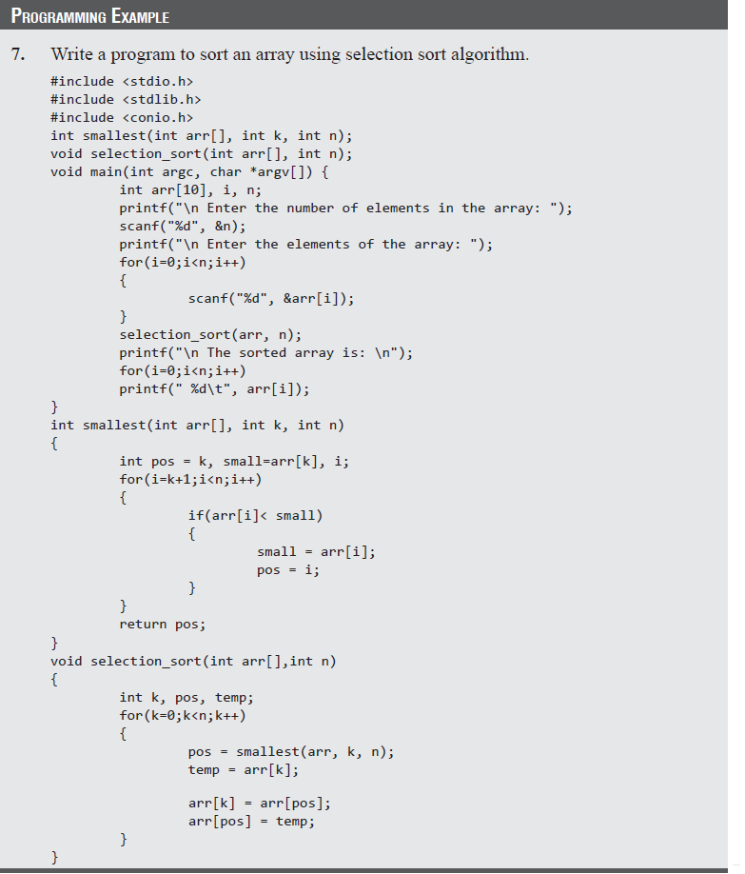
Selection Sort

Slide 49
Merge Sort
Merge sort is a sorting algorithm that uses the divide, conquer, and combine algorithmic paradigm.
Divide means partitioning the n-element array to be sorted into two sub-arrays of n/2 elements. If A is an array containing zero or one element, then it is already sorted. However, if there are more elements in the array, divide A into two sub-arrays, A1 and A2, each containing about half of the elements of A.
Conquer means sorting the two sub-arrays recursively using merge sort.
Combine means merging the two sorted sub-arrays of size n/2 to produce the sorted array of n elements.

Slide 50
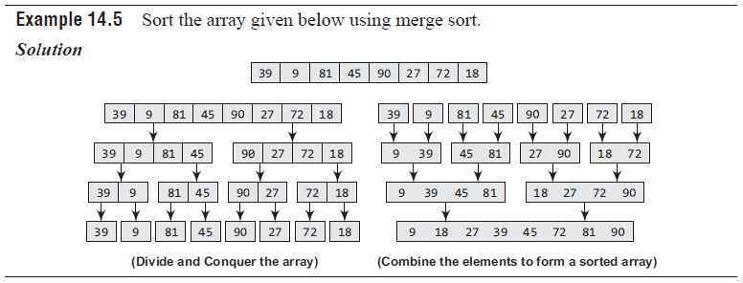
Merge Sort

Slide 51
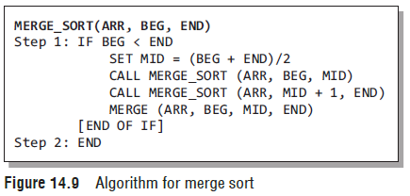
Merge Sort
The merge sort algorithm (Fig. 14.9) uses a function merge which combines the sub-arrays to form a sorted array.
While the merge sort algorithm recursively divides the list into smaller lists, the merge algorithm conquers the list to sort the elements in individual lists.
Finally, the smaller lists are merged to form one list.

Slide 52
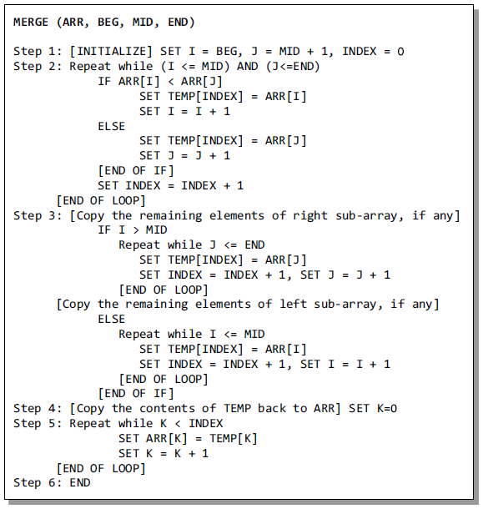
Merge Sort

Slide 53
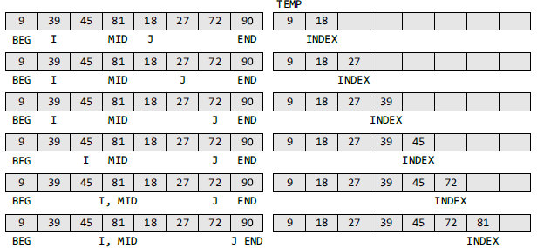
Merge Sort
To understand the merge algorithm, consider the figure below which shows how we merge two lists to form one list.
For ease of understanding, we have taken two sub-lists each containing four elements.
The same concept can be utilized to merge four sub-lists containing two elements, or eight sub-lists having one element each.
Compare ARR[I] and ARR[J], the smaller of the two is placed in TEMP at the location specified by INDEX and subsequently the value I or J is incremented.
When I is greater than MID, copy the remaining elements of the right sub-array in TEMP.

Slide 54
Merge Sort
Complexity of Merge Sort
The running time of merge sort in the average case and the worst case can be given as O(n log n). Although merge sort has an optimal time complexity, it needs an additional space of O(n) for the temporary array TEMP.

Slide 55
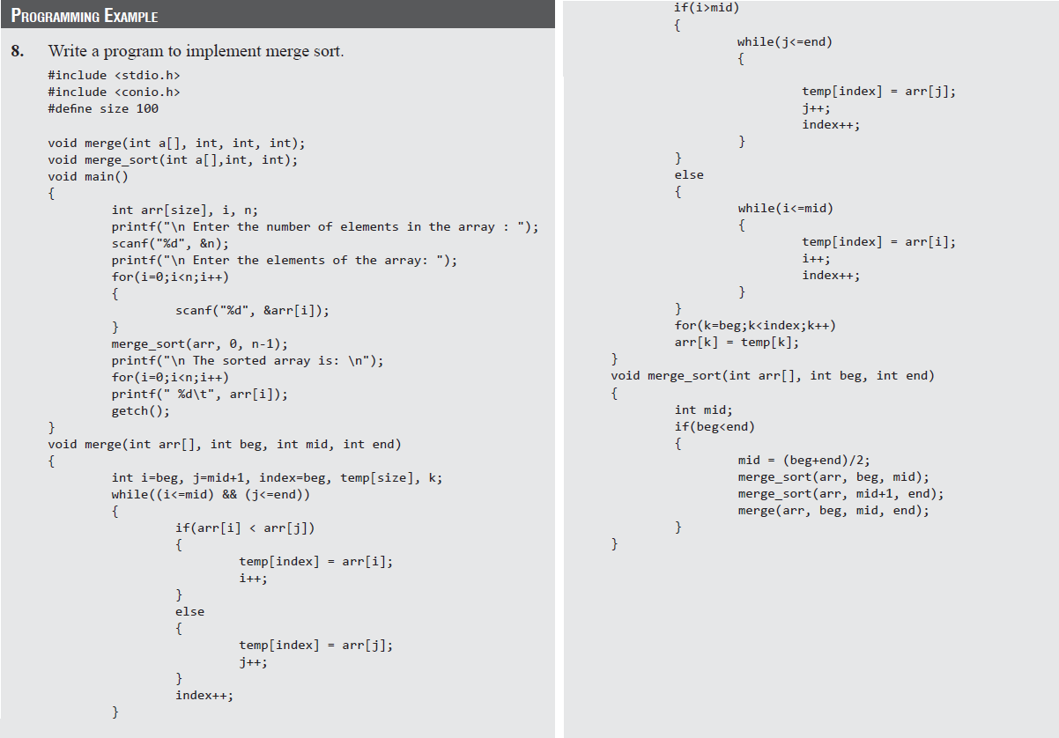
Merge Sort

Slide 56
Quick Sort
Quick sort is a widely used sorting algorithm developed by C. A. R. Hoare that makes O(n log n) comparisons in the average case to sort an array of n elements.
However, in the worst case, it has a quadratic running time given as O(n²).
Like merge sort, this algorithm works by using a divide-and-conquer strategy to divide a single unsorted array into two smaller sub-arrays.
The quick sort algorithm works as follows:
Select an element pivot from the array elements.
Rearrange the elements in the array in such a way that all elements that are less than the pivot appear before the pivot and all elements greater than the pivot element come after it (equal values can go either way). After such a partitioning, the pivot is placed in its final position. This is called the partition operation.
Recursively sort the two sub-arrays thus obtained. (One with sub-list of values smaller than that of the pivot element and the other having higher value elements.)

Slide 57
Quick Sort
Like merge sort, the base case of the recursion occurs when the array has zero or one element because in that case the array is already sorted.
After each iteration, one element (pivot) is always in its final position.
Hence, with every iteration, there is one less element to be sorted in the array.
Thus, the main task is to find the pivot element, which will partition the array into two halves.

Slide 58
Quick Sort
Technique
Quick sort works as follows:
Set the index of the first element in the array to loc and left variables. Also, set the index of the last element of the array to the right variable. That is, loc = 0, left = 0, and right = n–1 (where n in the number of elements in the array)
Start from the element pointed by right and scan the array from right to left, comparing each element on the way with the element pointed by the variable loc. That is, a[loc] should be less than a[right].
If that is the case, then simply continue comparing until right becomes equal to loc. Once right = loc, it means the pivot has been placed in its correct position.
However, if at any point, we have a[loc] > a[right], then interchange the two values and jump to Step 3.
Set loc = right
Start from the element pointed by left and scan the array from left to right, comparing each element on the way with the element pointed by loc. That is, a[loc] should be greater than a[left].
If that is the case, then simply continue comparing until left becomes equal to loc. Once left = loc, it means the pivot has been placed in its correct position.
However, if at any point, we have a[loc] < a[left], then interchange the two values and jump to Step 2.
Set loc = left.

Slide 59
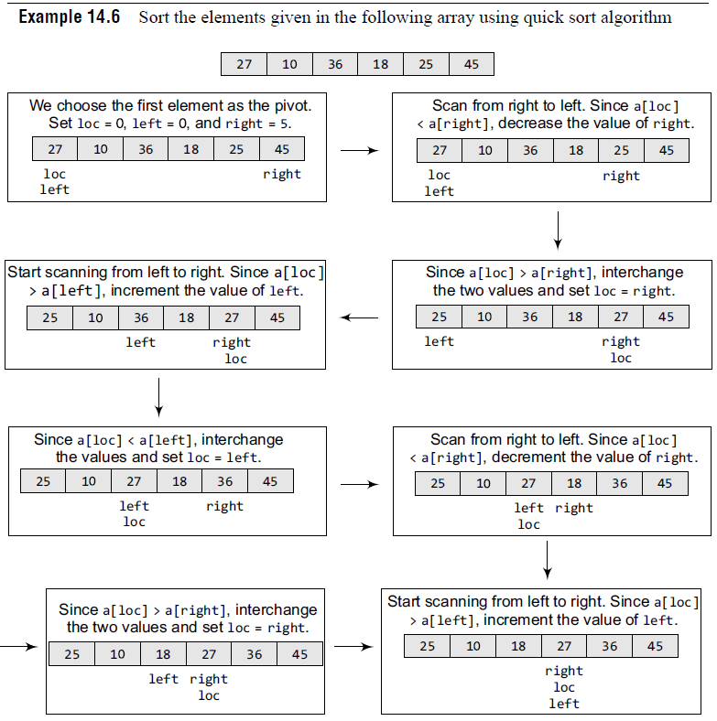
Quick Sort
Now left = loc, so the procedure terminates, as the pivot element (the first element of the array, that is, 27) is placed in its correct position. All the elements smaller than 27 are placed before it and those greater than 27 are placed after it. The left sub-array containing 25, 10, 18 and the right sub-array containing 36 and 45 are sorted in the same manner.

Slide 60
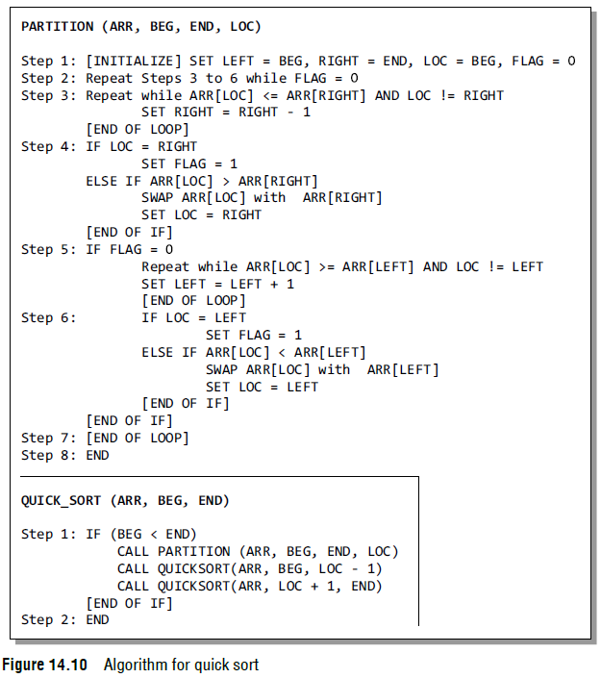
Quick Sort
The quick sort algorithm (Fig. 14.10) makes use of a function Partition to divide the array into two sub-arrays.

Slide 61
Quick Sort
Complexity of Quick Sort
In the average case, the running time of quick sort can be given as O(nlog n).
The partitioning of the array which simply loops over the elements of the array once uses O(n) time.
In the best case, every time we partition the array, we divide the list into two nearly equal pieces. That is, the recursive call processes the sub-array of half the size. At the most, only log n nested calls can be made before we reach a sub-array of size 1. It means the depth of the call tree is O(log n). And because at each level, there can only be O(n), the resultant time is given as O(n log n) time.
Practically, the efficiency of quick sort depends on the element which is chosen as the pivot.
Its worst-case efficiency is given as O(n2). The worst case occurs when the array is already sorted (either in ascending or descending order) and the left-most element is chosen as the pivot.
However, many implementations randomly choose the pivot element. The randomized version of the quick sort algorithm always has an algorithmic complexity of O(n log n).

Slide 62
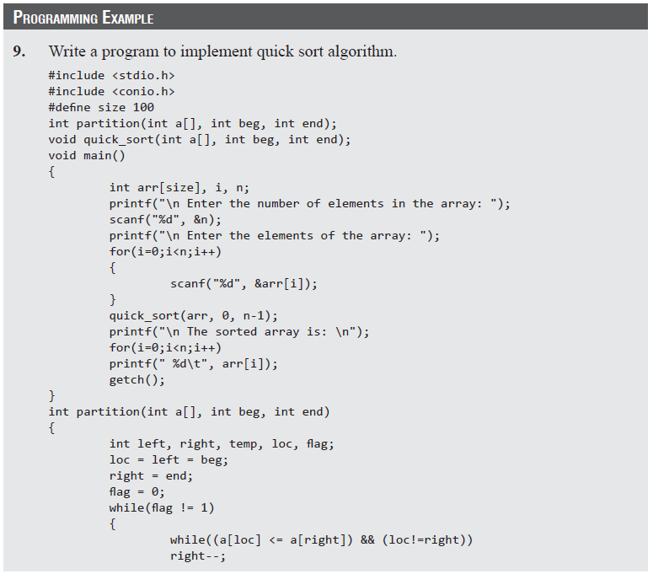
Quick Sort

Slide 63
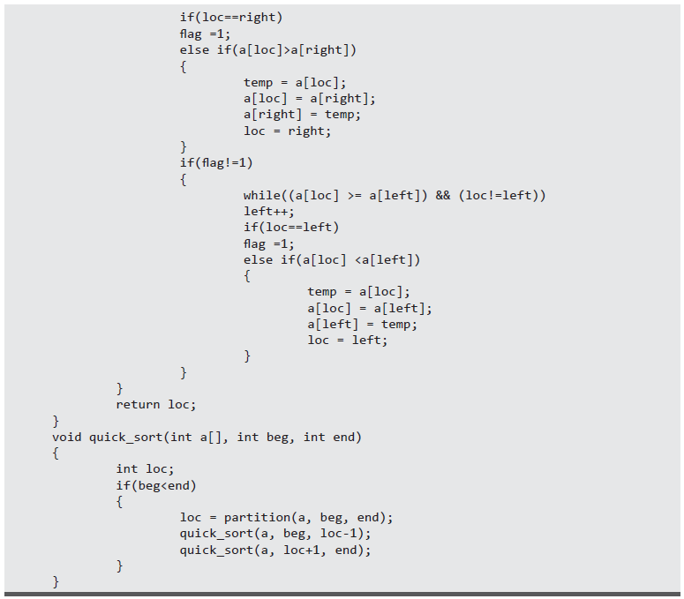
Quick Sort

Slide 64
Radix Sort
Radix sort is a linear sorting algorithm for integers and uses the concept of sorting names in alphabetical order.
When we have a list of sorted names, the radix is 26 (or 26 buckets) because there are 26 letters in the English alphabet.
Observe that words are first sorted according to the first letter of the name.
During the second pass, names are grouped according to the second letter. After the second pass, names are sorted on the first two letters. This process is continued till the nth pass, where n is the length of the name with maximum number of letters.
When radix sort is used on integers, sorting is done on each of the digits in the number. The sorting procedure proceeds by sorting the least significant to the most significant digit. While sorting the numbers, we have ten buckets, each for one digit (0, 1, 2, …, 9) and the number of passes will depend on the length of the number having maximum number of digits.

Slide 65
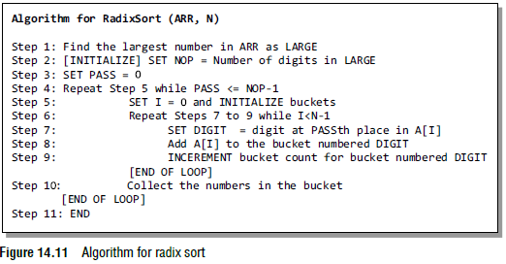
Radix Sort

Slide 66
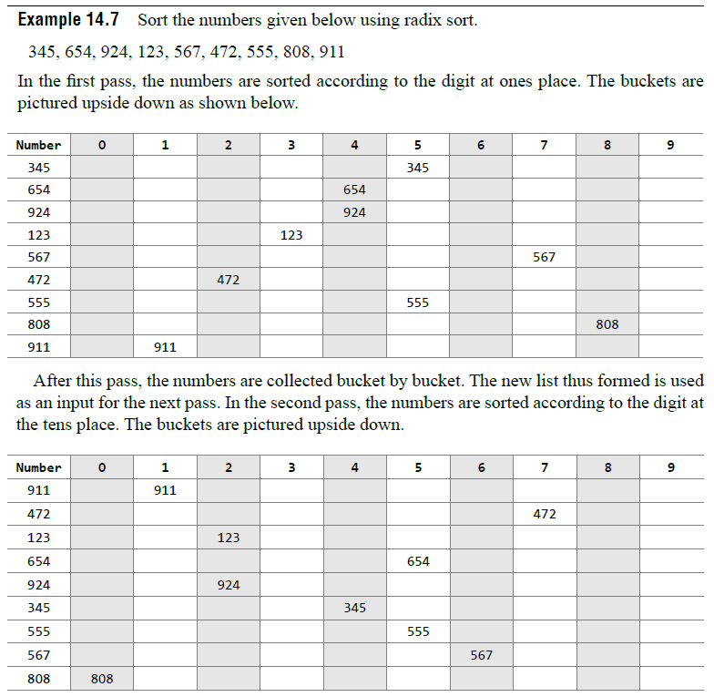
Radix Sort

Slide 67
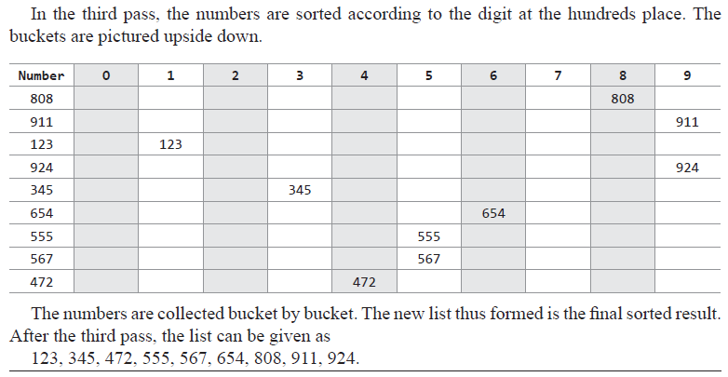
Radix Sort
Complexity of Radix Sort
To calculate the complexity of radix sort algorithm, assume that there are n numbers that have to be sorted and k is the number of digits in the largest number.
In this case, the radix sort algorithm is called a total of k times.
The inner loop is executed n times.
Hence, the entire radix sort algorithm takes O(kn) time to execute.
When radix sort is applied on a data set of finite size (very small set of numbers), then the algorithm runs in O(n) asymptotic time.

Slide 68
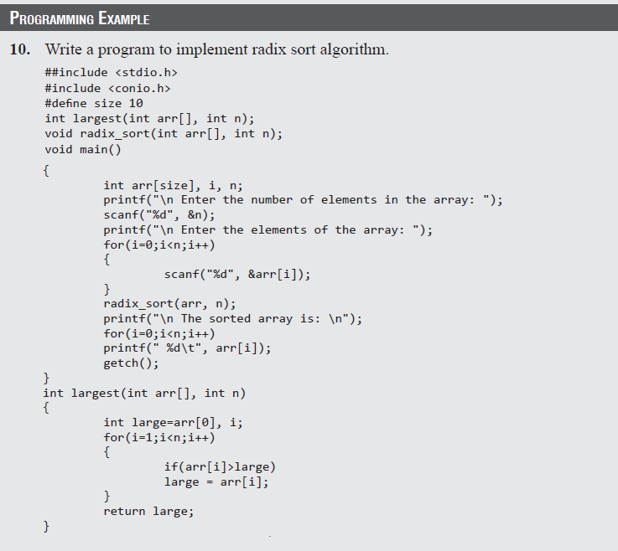
Radix Sort

Slide 69
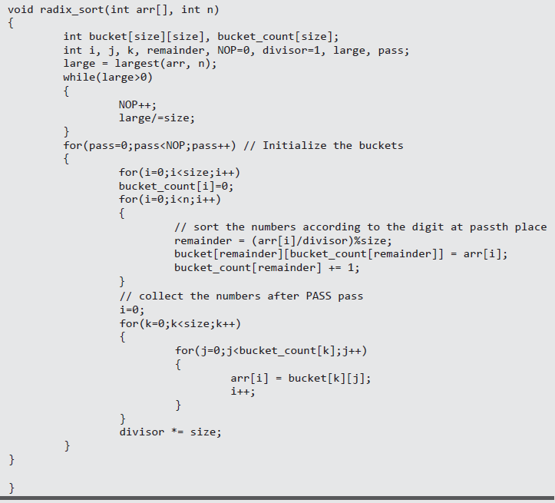
Radix Sort

Slide 70
Shell Sort
Shell sort, invented by Donald Shell in 1959, is a sorting algorithm that is a generalization of insertion sort. While discussing insertion sort, we have observed two things:
First, insertion sort works well when the input data is ‘almost sorted’.
Second, insertion sort is quite inefficient to use as it moves the values just one position at a time.
Shell sort is considered an improvement over insertion sort as it compares elements separated by a gap of several positions. This enables the element to take bigger steps towards its expected position. In Shell sort, elements are sorted in multiple passes and in each pass, data are taken with smaller and smaller gap sizes. However, the last step of shell sort is a plain insertion sort. But by the time we reach the last step, the elements are already ‘almost sorted’, and hence it provides good performance.

Slide 71
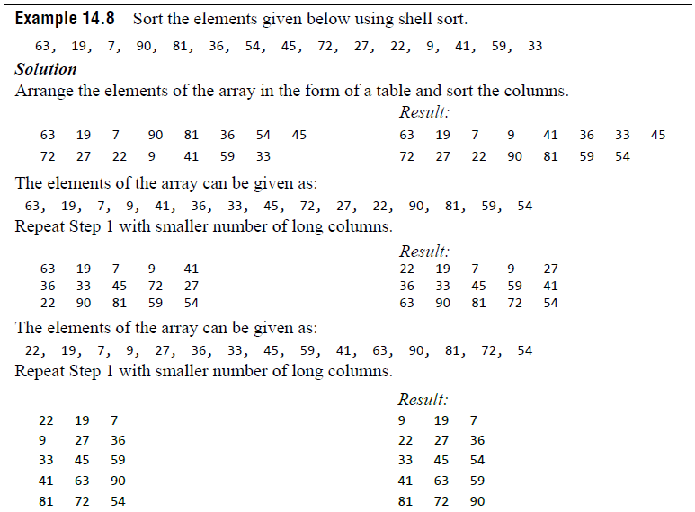
Shell Sort

Slide 72
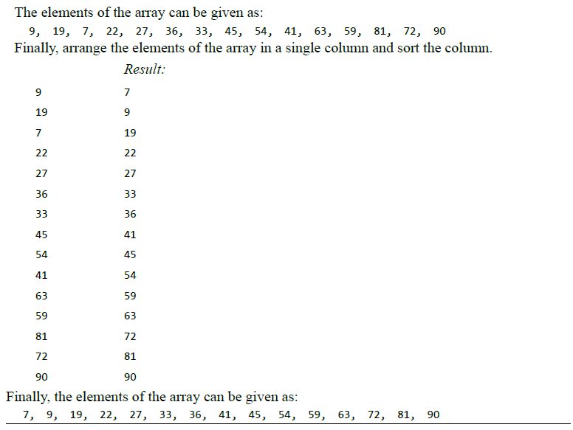
Shell Sort

Slide 73
Shell Sort
Technique
To visualize the way in which shell sort works, perform the following steps:
Step 1: Arrange the elements of the array in the form of a table and sort the columns (using insertion sort).
Step 2: Repeat Step 1, each time with smaller number of longer columns in such a way that at the end, there is only one column of data to be sorted.
Note that we are only visualizing the elements being arranged in a table, the algorithm does its sorting in-place.

Slide 74
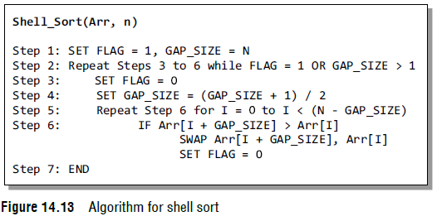
Shell Sort
The algorithm to sort an array of elements using shell sort is shown in Fig. 14.13.
In the algorithm, we sort the elements of the array Arr in multiple passes.
In each pass, we reduce the gap_size (visualize it as the number of columns) by a factor of half as done in Step 4.
In each iteration of the for loop in Step 5, we compare the values of the array and interchange them if we have a larger value preceding the smaller one.

Slide 75
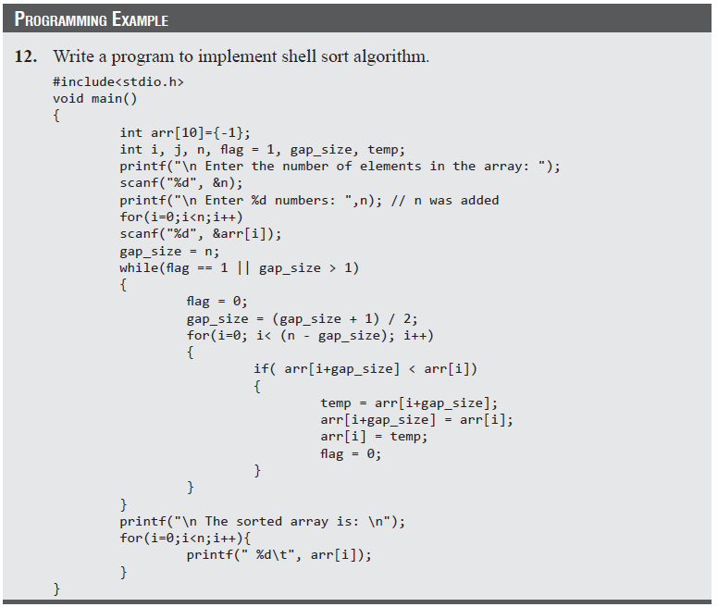
Shell Sort

Slide 76
Tree Sort
A tree sort is a sorting algorithm that sorts numbers by making use of the properties of binary search tree.
The algorithm first builds a binary search tree using the numbers to be sorted and then does an in-order traversal so that the numbers are retrieved in a sorted order.

Slide 77
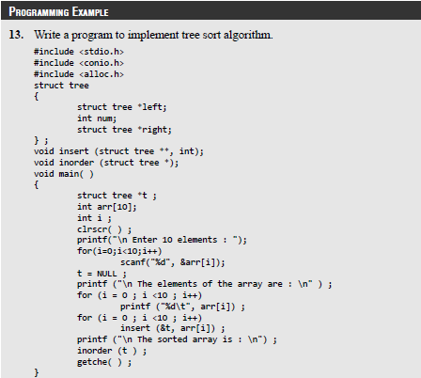
Tree Sort

Slide 78
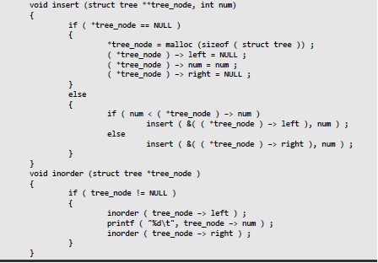
Tree Sort

Slide 79
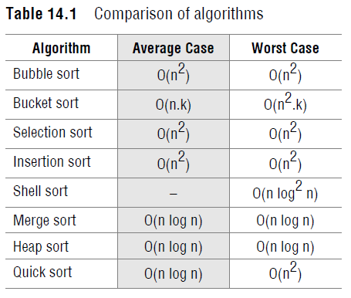
Comparison of Sorting Algorithms
Table 14.1 compares the average-case and worst-case time complexities of different sorting algorithms discussed so far.

